Slide 1
A Review of Division II & III – Downtown Focus

Slide 2

Agenda
Zoning Code Relationship to General Plan
Update Objectives
Zoning Map
Permitted Uses
Development / Design Standards
Topics of Interest
Next Steps

Slide 3
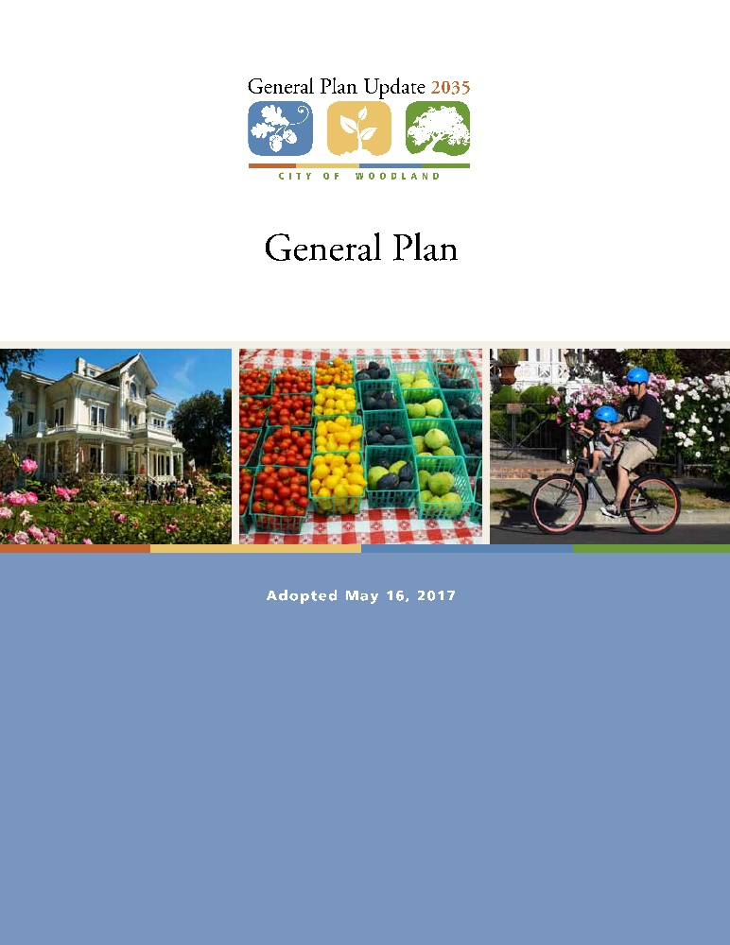
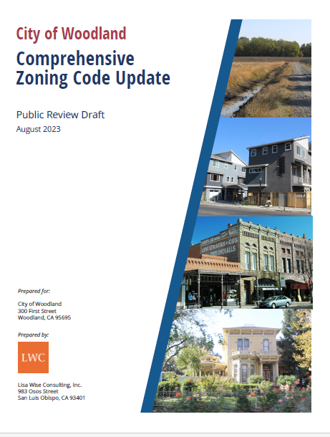
Zoning Code Relationship to General Plan
The Zoning Code is a tool that implements the goals and policies of the General Plan
Woodland’s General Plan was updated in May 2017 after a four year planning and review process involving community members, local stakeholders, and based on the guidance and direction of elected and appointed officials
The General Plan establishes goals and policies for the future growth of the City including where development should happen, the types of development and the intensity of development
The Zoning Code and General Plan shall be consistent with each other
Notes:
A zoning ordinance is the local law that spells out the immediate, allowable uses for each piece of property within the community.
Each piece of property in the community is assigned a zone listing the kinds of uses that will be allowed on that land and setting standards such as minimum lot size, maximum building height, and minimum front yard depth. The distribution of residential, commercial, industrial, and other zones are based on the pattern of land uses established in the City's General Plan. Maps are used to keep track of the zoning for each piece of land, which we will look at…
Ultimately the Zoning Code is a tool that implements the goals and policies of the General Plan
In 2017, the City updated it’s General Plan, which is the “blueprint” for growth and development in the City over a 15-20 year planning horizon. Based on the adopted goals and policies of the General Plan, some aspects of the then current Zoning Code were outdated. The City did adopt an Interim Code to address significant inconsistencies until this Comprehensive Code update could be completed.

Slide 4
Why Update the Zoning Code?
Existing Zoning Code is problematic:
  Outdated and disjointed
  Difficult for staff, community and development partners to use
  Does fully address General Plan policies and intent
  Does not adequately address climate and sustainability
  Does not fully address entitlement review requirements
  Requires review of multiple other documents (Interim Zoning, Community Design Standards, Downtown Specific Plan)
  Does not have fully objective standards
  Lack of graphics and definitions
Notes:
In addition to General Plan inconsistencies, Other reasons to look comprehensively at a code update include…

Slide 5
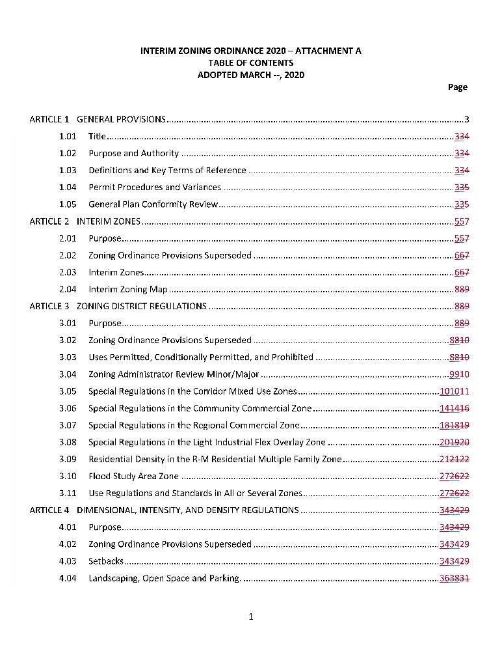
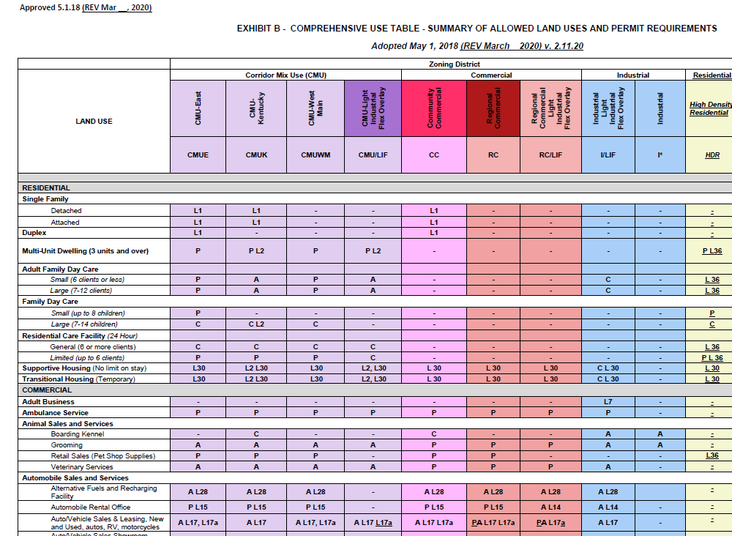
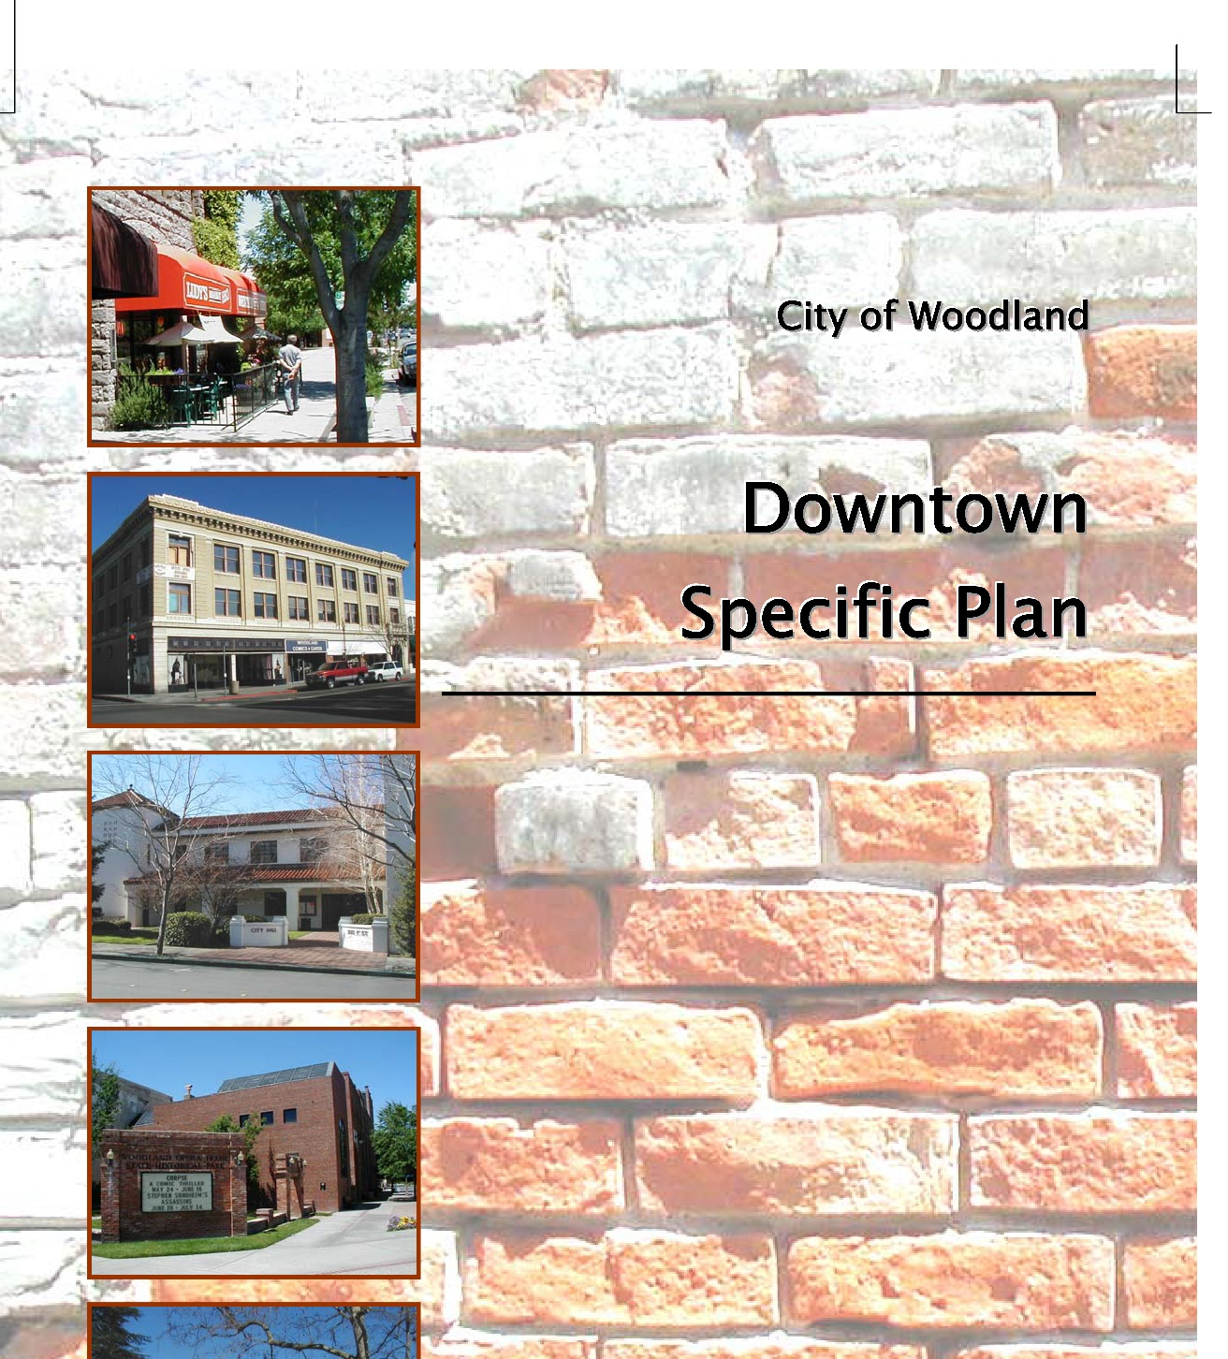
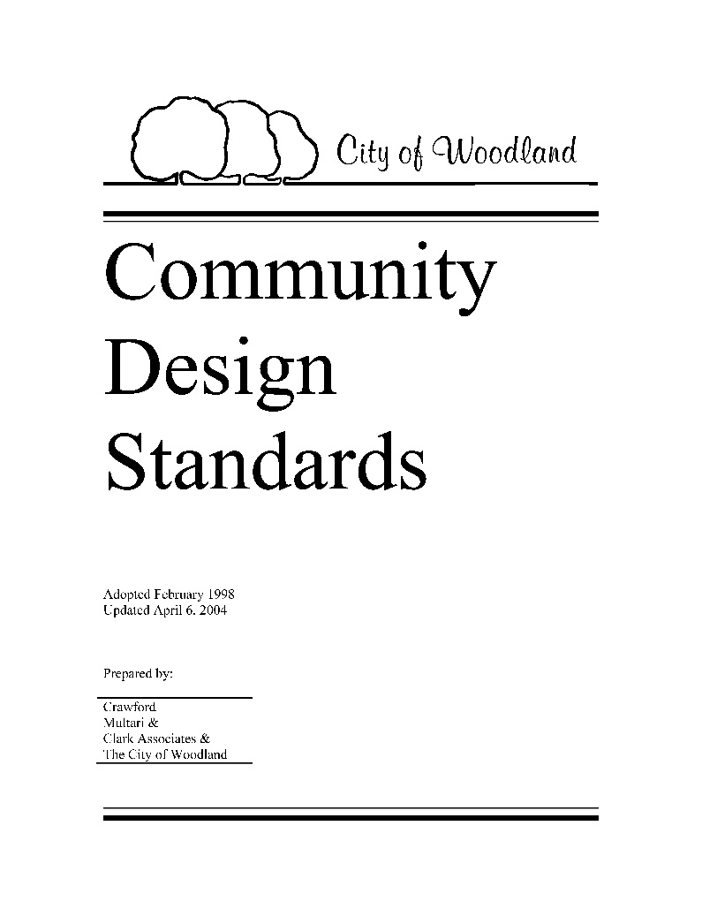
Project Objectives
Implement the City’s General Plan policies
Reflect community character
Respond to economic realities and trends
Facilitate reinvestment in the community and development of housing for all segments
Build on Interim Zoning
Create a legally adequate regulatory document
Be user-friendly and all in one document
Streamline and simplify project review
Notes:
The goal of the CZC update is to facilitate new desired development through the provision of clear and understandable standards, guidelines, and procedures. An updated development review process will assist staff and decision makers to allow qualified development with expedited review, thereby helping to reduce the front-end design/development costs particularly for new businesses and new housing projects.

Slide 6
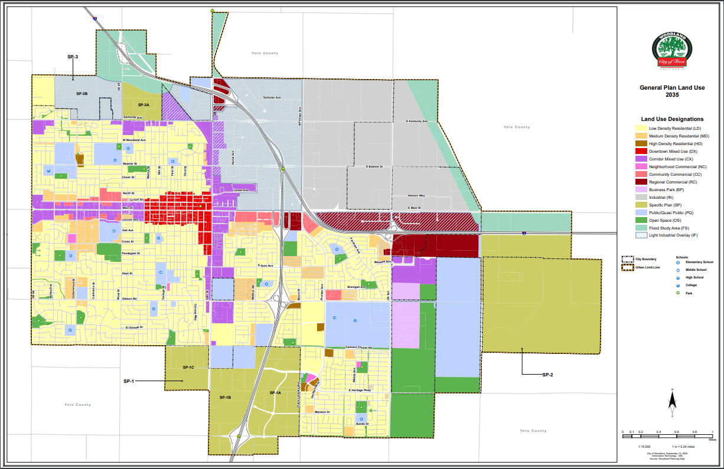
General Plan Land Use Designation Map
Downtown Mixed Use (DX)
Notes:
Start by looking at the direction provided by the General Plan.
Here we have the General Plan Land Use Designation Map. The GP identifies the Downtown Mixed Use district in red on this map.

Slide 7
General Plan Guidance
The Downtown Mixed Use (DX) designation applies to Woodland’s historic downtown core and is established to create:
  A vibrant city center
  A diverse mix of office, housing, theaters retail stores, professional services, and restaurants
  Technology uses, arts and crafts studio spaces and live/work units are encouraged to be integrated
  Attract/retain uses that serve residents, employees and night-time entertainment populations
General Plan Development Standards
  Allowable Floor Area Ratio 1.0 to 4.0
  Unlimited residential density
  Vertical mixed use is strongly encouraged on Main Street
Notes:
Read slide
Floor Area Ratio is a measurement of development intensity. Kind of a geeky Planning term, but 4.0 is the highest FAR allowed in the City. Signfies that in general the city is supportive of full build out of development sites, including multiple stories of development.

Slide 8
General Plan Related Goals and Policies
Goal 2.F Distinctive and Memorable Places. Promote community design that produces a distinctive, high-quality built environment, with form and character that reflects Woodland’s unique historic, environmental, and architectural context and creates memorable places…
Goal 2.H Historic Downtown Center. Promote Downtown Woodland as a premier urban location…with a dynamic mix of uses including shopping, dining, entertainment, living, and employment ranging from innovative businesses to traditional government functions. Encourage architecturally interesting buildings and inviting pedestrian streetscapes that complement the city’s historic character while celebrating the ingenuity of the present.
Policy 2.A.4 Downtown. Promote Downtown Woodland as the city’s sole civic, cultural, entertainment, and central business district that serves as the primary specialty-retail and dining, entertainment, office, arts, and government center. Support new mixed-use development in the Downtown...
Policy 2.H.1 Mixed Use. Support new mixed-use development Downtown with an emphasis on ground-level retail and dining with upper-story residential and office uses…. Encourage an active and vibrant Downtown with a 24/7 presence by allowing a mix of entertainment, retail, and cultural uses as well as residential and office uses.
Policy 2.H.2 Facade Improvements. Encourage contextually appropriate building and façade improvements to promote Downtown as a pedestrian-oriented retail and services area
Policy 2.H.3 Streamlined Review. Streamline the review and permitting process for all building improvements within the Downtown.
Policy 2.H.7 Entertainment Focus. Promote Downtown as an entertainment and cultural activity center for the city, county, and region…
Notes:
Highlight a few GP goals / policies…again laying the foundation for the Zoning code use, development and design standards…

Slide 9
Downtown Zoning Objectives
Permitted Use Table updated to reflect desired uses consistent with General Plan goals/policies for a vibrant and active Downtown District
Simplify and streamline review and approval of desired uses
Consolidate standards into one comprehensive document
Retain the “best of” guidance and standards from the Downtown Specific Plan
Continue to promote preservation and reuse of historic buildings/resources
Ensure attractive and complimentary new development through objective design standards
Notes:
Based on those GP policies, a few objectives for the zoning code update specific to the downtown…

Slide 10
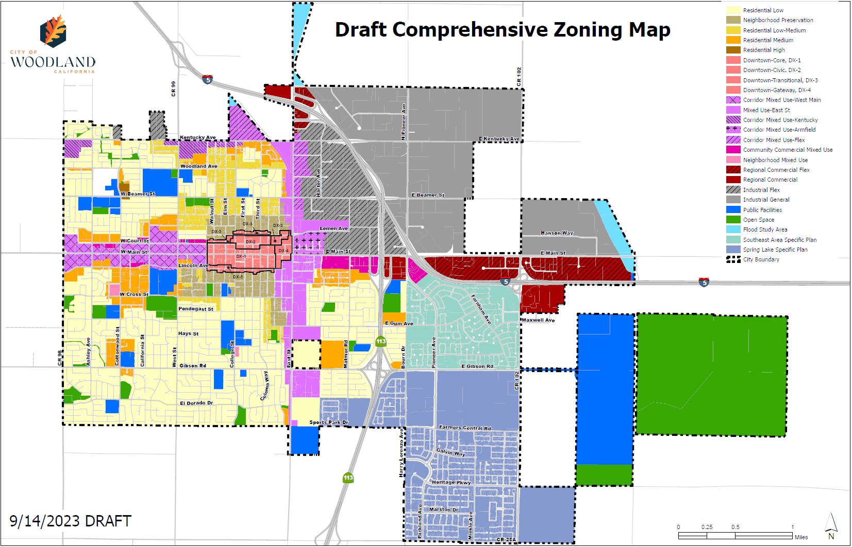
Notes:
Draft comprehensive zoning map…can see Downtown in Salmon color in the center…

Slide 11
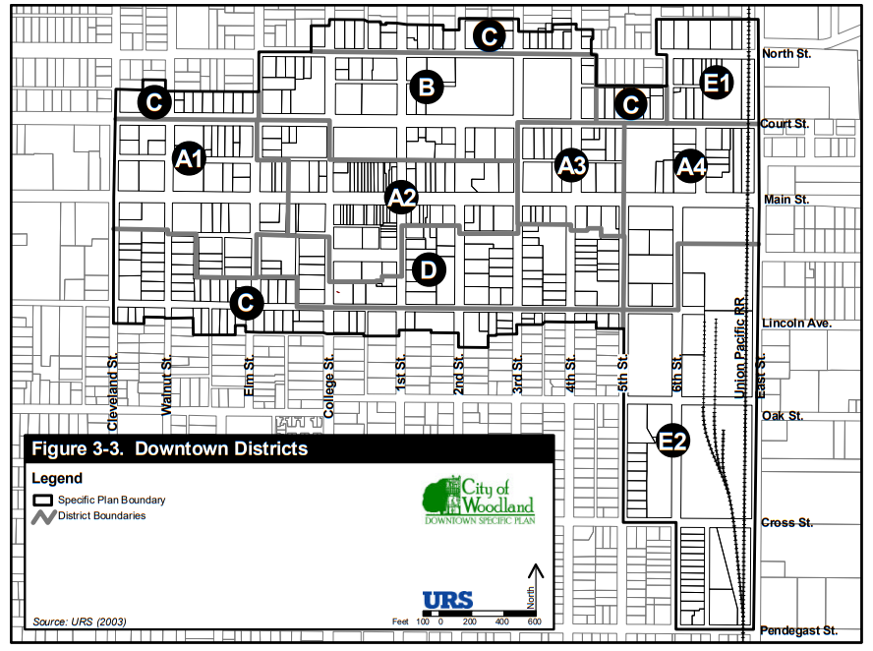
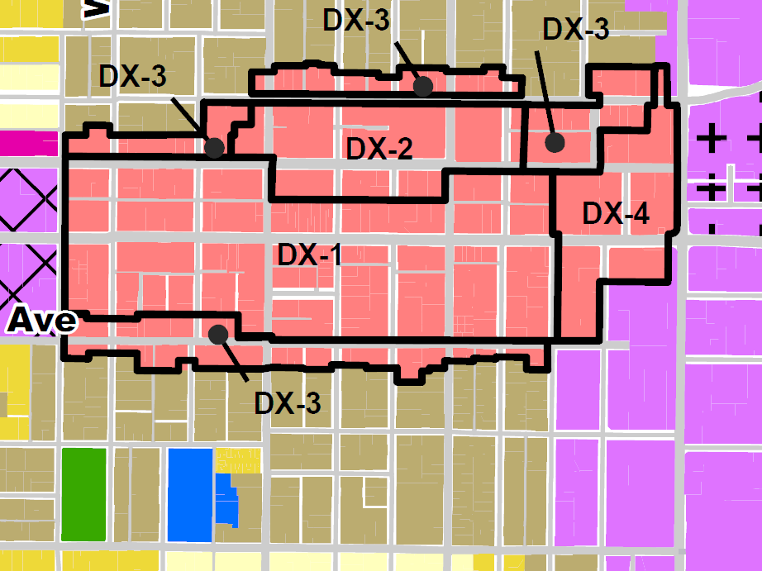
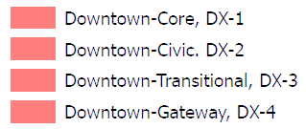
Current Downtown Specific Plan Districts
Proposed Downtown Zones
Main St
A – Main Street
B – Government Center
C - Transitional District
D - Mixed Use District
E - Gateway District
Notes:
Here we have a close up view of the proposed Downtown or DX zones…also the current zoning from the Downtown Specific plan.
The new zones, DX-1 through DX-4 are reflective of the DSP District map but have been simplified. In 2017 a detailed assessment of the Downtown was conducted under the direction of then Deputy Director Steve Coyle and included several community members and the revised boundaries were recommended. Staff more recently conducted some additional ground reconnaissance to further define and verify proper district boundaries.
The current DSP includes 5 Districts and several subdistricts. Each Ditrict having its own set of allowed uses and development standards. The proposed zoning includes 4 districts.
The biggest change to the zoning includes combining what was two districts, “Main Street” and “Mixed Use District” generally along and just off of Main Street, and combines those two areas into one “Core” DX-1 District. This is in recognitions that the Core downtown district is more than just those businesses fronting Main Street…that we want to carry similar uses off of Main Street. However updated development standards do acknowledge and respect lower intensity uses off of Main Street (existing single family homes).
The proposed zoning retains the Government or Civic District where you have the county courthouse, woodland library, legal offices, public parking areas, etc. Downtown Civic (DX-2). The Downtown Civic zone is intended to support a mix of public uses and offices, housing, retail, professional services, and open space in the Court Street corridor of Woodland’s historic downtown core. The zone envisions both vertical and horizontal mix of uses that support a vibrant and walkable civic-oriented downtown district.
Proposed zoning retains the Transition District…Downtown Transitional (DX-3). The Downtown Transitional zone is intended to support a mix of offices, housing, and active uses on the edges of Woodland’s historic downtown core. Centered on the Lincoln Avenue and North Street corridors, this zone provides a transition from the downtown core to the residential neighborhoods north and south of the zone. The zone supports vertical and horizontal mixed-use development with a lower intensity urban feel that provides walkable transition to the residential neighborhoods to the north and south.
A new District is DX-4 or the Gateway District, recognizing that this area presents an important infill opportunity and there certain uses and development types important for this location…The Downtown Gateway zone supports a vibrant mixed-use node at the primary entry point to Woodland’s historic downtown core. Centered on Main Street between 5th Street and East Street, the DX-4 zone facilitates a mix of uses and open spaces that welcome residents and visitors to the Downtown, that intensify opportunity areas abutting the railroad, and that ensure appropriate transitions to the corridor, downtown, and residential areas. The DX-4 zone implements areas of the Downtown Mixed Use General Plan land use designation.
The new zoning recommends removing what was the Gateway District or Area E in the DSP. That area more realistically aligns with the East Street Mixed Use District.

Slide 12
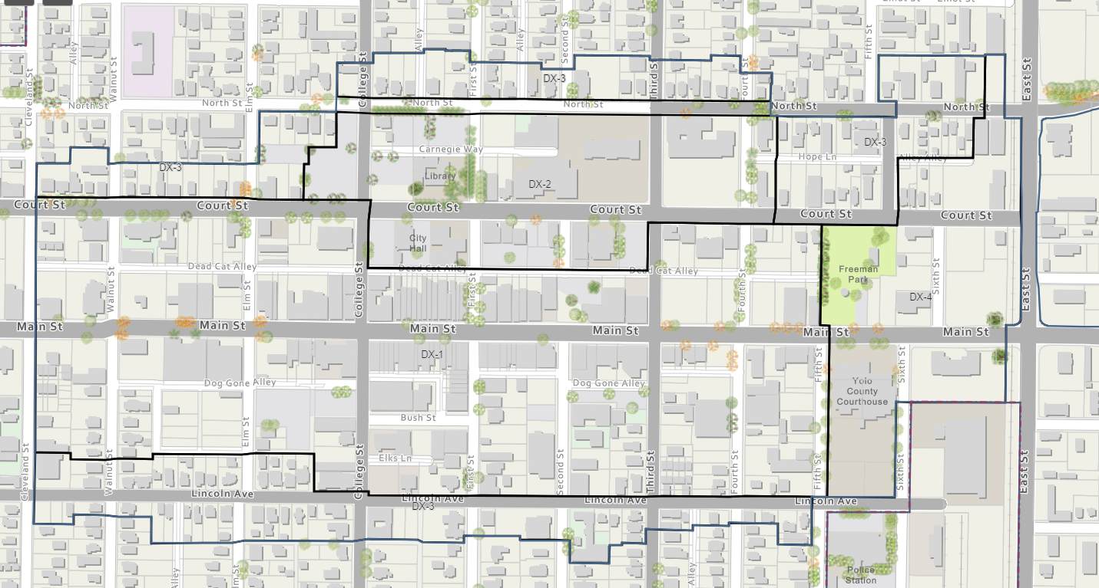
DX-3 – Transitional
DX-2 – Civic
DX-3
DX-3
DX-4 –
Gateway
DX-1 – Downtown Core
DX-3 – Transitional
East Street CMU
Notes:
Another view of the DX Zones.

Slide 13
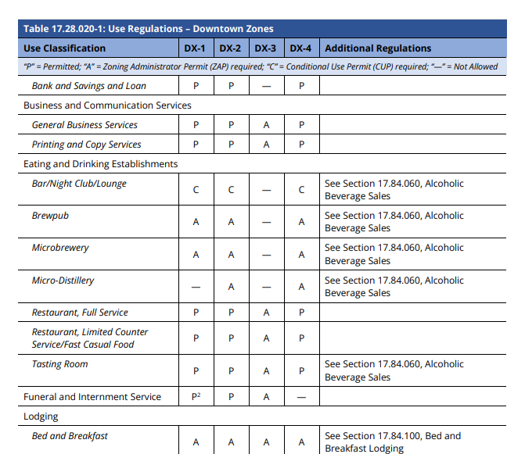
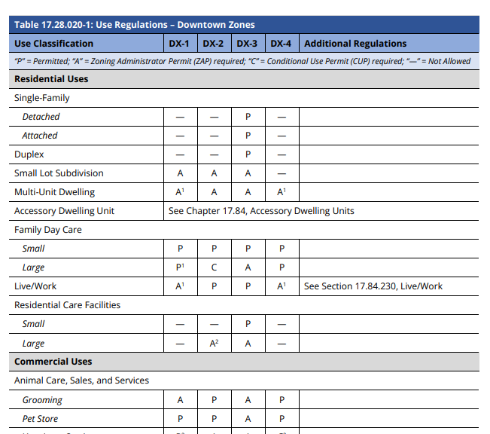
Notes:
Hand out use table.

Slide 14
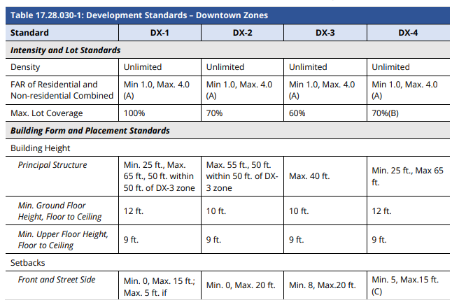
Development Standards – DX Zones
Notes:
Moving into Division II of the code, where development standards are outlined.
Most of these standards reflect the existing pattering and design/layout characteristics of the Downtown and are generally consistent with what the Downtown Specific Plan currently allows.
We’ve talked about unlimited residential density – same
Lot coverage (how much of a building can cover a parcel/lot) was bumped up slightly for DX-2 (Civic District), otherwise pretty much consistent with current.
Building Height, we have added minimums to ensure optimal use of development sites. Max along Main Street and in the Core area remains the same 65’, except that this new code provides better transitions between the core district and lower intensity transition districts as well as adjacent residential neighborhoods or uses….heights are limited to 50 feet as you approach the DX-3 transitional district and then the height limit in DX-3 itself is now 40’ down from 65’.
Front Setbacks are still basically 0’ along Main Street and in the Core District. We’ve added maximum setbacks to make sure buildings help define and hold the street wall…maintaining Downtown as a pedestrian oriented district. However, those maximums can be increased for outdoor plazas or dining.

Slide 15
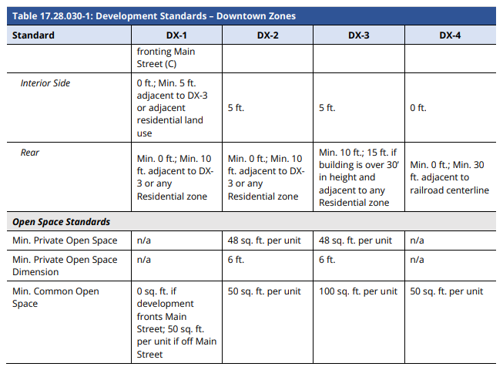
Development Standards – DX Zones
Notes:
Rear setbacks are also 0 or 10’, but may increase where properties back up to existing residential development to provide some buffer distance.
The updated code provides private and shared open space requirements for residential development.

Slide 16
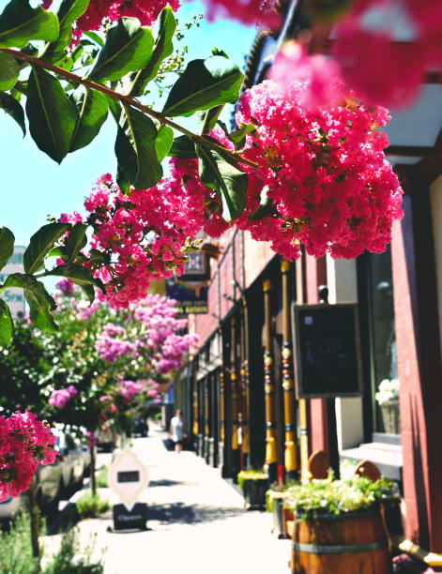
CZC - Division II
17.56: Building and Site Design Standards
17.56.010 General Design Standards
17.56.020 Single-Family and Duplex Design Standards
17.56.030 Multi-Unit Design Standards
17.56.040 Small Lot Subdivision Design Standards
17.56.050 Preservation/Restoration of and Additions to Historic Structures
17.56.060 New Development or Renovation of Non-Historic Structures Design Standards in the Downtown Zones
17.56.070 Mixed Use, Commercial and Employment Zones Design Standards
17.56.080 Public Facilities and Open Space Zones Design Standards
Additions
Restorations
Architectural Features
Windows
Materials
Awnings
Building Code Requirements (CA Historic Building Code)
Demolitions
Notes:
Division II also covers design standards that speak more directly to site planning and architecture.
The first section application to the Downotwn area speaks to Preservation/Resotration of and addiitons to historic structures.
This section applies to Projects involving the alteration of Designated Historic Resources.
Many of the guidelines around restoration work, architectural details, materials, etc. were carried over straight from the DSP, always with the goal of retaining and properly restoring buildings character defining architectural features.

Slide 17
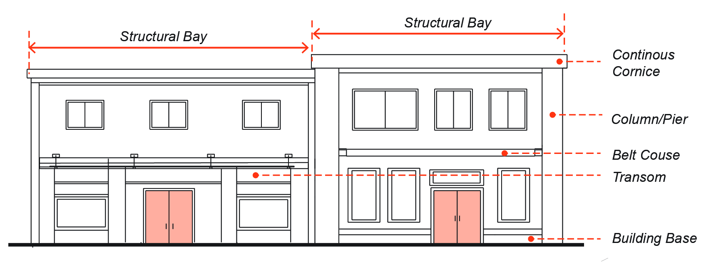
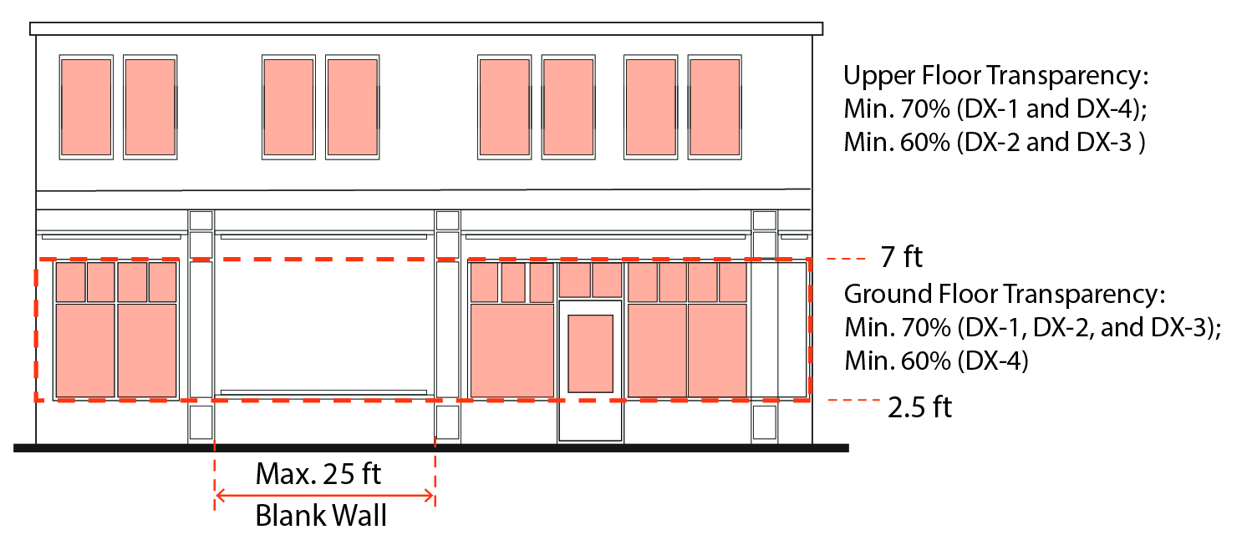
Division II: Zoning Regulations
17.56: Building and Site Design Standards
17.56.010 General Design Standards
17.56.020 Single-Family and Duplex Design Standards
17.56.030 Multi-Unit Design Standards
17.56.040 Small Lot Subdivision Design Standards
17.56.050 Preservation/Restoration of and Additions to Historic Structures
17.56.060 New Development or Renovation of Non-Historic Structures Design Standards in the Downtown Zones
17.56.070 Mixed Use, Commercial and Employment Zones Design Standards
17.56.080 Public Facilities and Open Space Zones Design Standards
Orientation
Façade Design
Corner Treatment
Entrances
Roofs
Transparency
Blank Walls
Exterior Materials
Awnings and Canopies
Notes:
The next section applies to all infill development or renovation of non-historic structures in the Downtown zones.
Standards pertaining to new development in the Downtown speak to design elements such as building orientation, façade design, corner treatments, buildings entrances, window placement that reflects and compliments the character of the Downtown, but that doesn’t necessarily mean new buildings have to copy historic structures. What we’re really after is keeping buildings pedestrian oriented, einviting to and engaging with the public realm.

Slide 18

Topics of Note

Slide 19
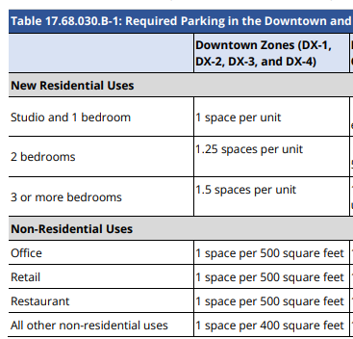
Parking and Loading
CZC Chapter 17.68
Existing buildings which currently operate in the Downtown zones are exempt from parking requirements, except:
  When a change in use, expansion of a use, or expansion of floor area creates an increase of 20 percent or more in the number of required on-site parking or loading spaces, additional on-site parking and loading shall be provided for such addition, enlargement, or change in use and not for the entire building or site; and/or
  With the creation of additional dwelling units (that did not formerly exist)
Other reduction options: Shared parking; secure bike parking; infeasibility of providing on-site parking and parking demand will not exceed the capacity of the supply of on-street parking…
Notes:
Parking requirements were updated in the code, however, consistent with prior downtown parking requirements, existing buildings which currently operate in the downtown are largely exempt from parking requirements.
If a new use, such as residential, is introduced, some additional on site parking may be required.
Parking requirements can be reduced through shared parking agreements, the provision of secure bike parking, and can in some cases by waived if there is no feasible option for on-site parking.
In other words, we do not want to discourage new uses and especially residential uses in the downtown because on site parking cannot be achieved. We will work to find a reasonable solutions and have provided flexibility in the code to allow for that.

Slide 20
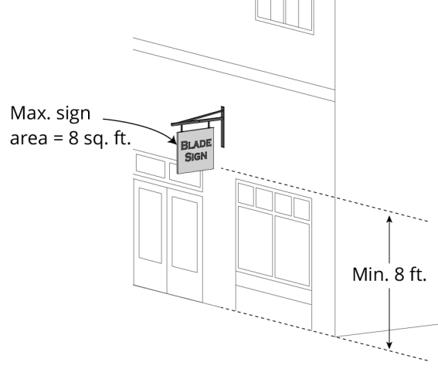
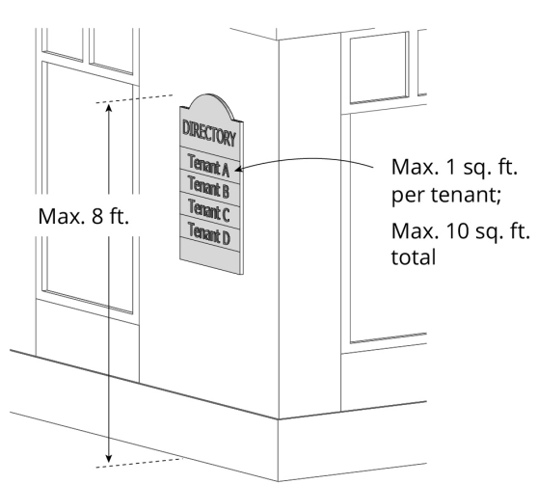
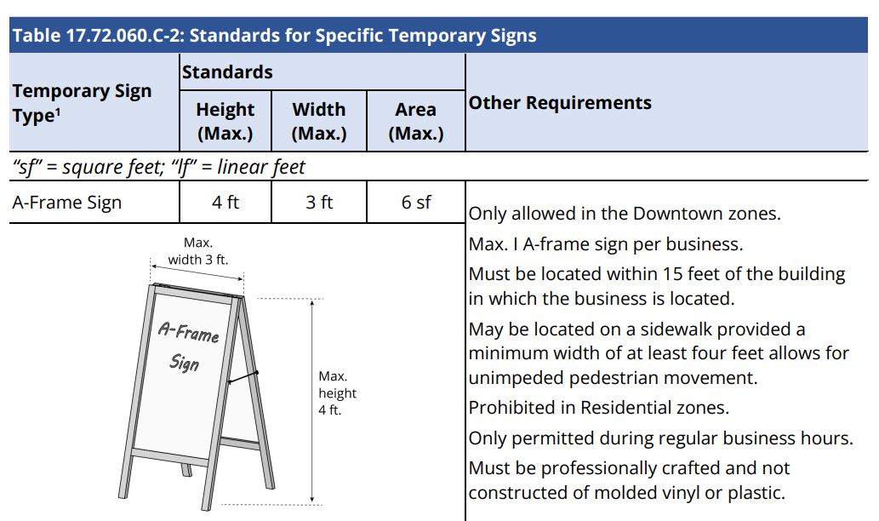
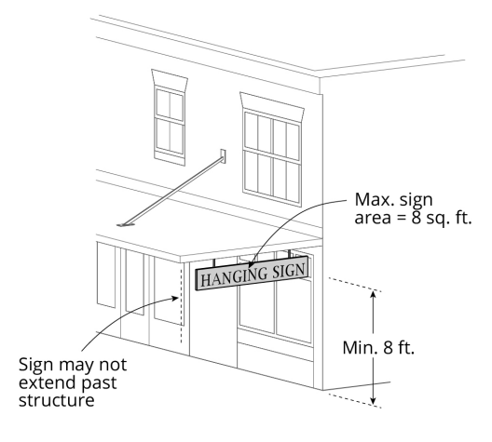
Signs
CZC Chapter 17.72
Notes:
Quick mention that the sign standards have been updated to be easier to interpret, including many graphics.

Slide 21
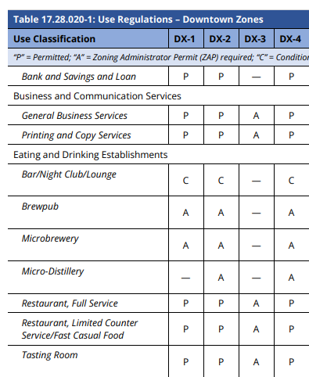
Alcoholic Beverage Sales
CZC Section 17.84.060
Requirements for On-Sale Liquor Establishments.
Permit Required. Unless otherwise specified, restaurants with alcohol sales, bars, nightclubs, and lounges, and alcoholic beverage retail sales establishments, shall not be established without first securing a Conditional Use Permit as required in the applicable base district.
  Exceptions. The following uses do not require a Conditional Use Permit:
    Veterans’ clubs and fraternal organizations.
    Full-service restaurants, defined as having gross receipts for food constituting 51 percent of all sales, that do not sell alcohol past 10:00 p.m.
    Membership organizations and clubs that are restricted to members and guests only.
    Non-profit temporary licenses.
    One-day on-sale licenses pursuant to Business and Professions Code Section 24045.1.
    Hotels or Motels that offer complimentary drinks to their guests.
Notes:
There is a new section on Alcholoci Beverage Sales, however most uses in the Downtown will only require a staff level review or will be permitted by-right.
Retail sales of alcohol if ancillary require a ZAP, if primary or large scale wine and beer (Bev Mo) CUP

Slide 22
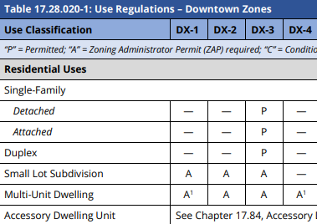
Housing
Housing density unlimited in the DX zones
Multi-unit projects are encouraged as stand alone off of Main Street, or above retail/commercial establishments fronting Main Street
Multi-unit project allowed with a Zoning Administrator Permit (ZAP) (staff level discretionary review)

Slide 23
Discussion
Notes:
We are looking forward to hearing feedback regarding the document. It is a draft and we understand that there may be new information that is discovered and comments received which could result in changes and updates.
Further, the Code is a living document, and even once approved, the document may continue to evolve over time as new situations and considerations present themselves.

Slide 24
Next Steps
Proposed Public Meeting Schedule:
Meetings may be subject to change, so please continue to check the CZC web site for up-to-date information.
Please join the City of Woodland staff at one or more of the scheduled workshops concerning the Public Review Draft Comprehensive Zoning Code Update on the following dates:
Thursday, October 5 @ 6:30 PM – Planning Commission Workshop
Wednesday, October 18 @6:00 PM – Commercial and Mixed-Use focus
Thursday, October 19 @6:30 PM – Planning Commission Workshop - Housing focus
Tuesday, October 24 @ 11:30 AM – General and Industrial focus
Wednesday, October 25 @ 9:00 AM – Downtown focus
All meetings will be held in the City Council Chambers, 300 First Street, City Hall and will be recorded and posted on the Comprehensive Zoning Code web page.
Notes:
The Team will begin to host a series of workshops and information sessions.
All meetings will be recorded and posted on the Comprehensive Zoning Code web page to allow members of the public the ability to view all presentations and discussions.
The city will offer a range of meeting types from pre-recorded to in person. If we are able, one or more may be hybrid with virtual attendance allowed. In person meetings will be held at the City of Woodland Council Chambers, located at 300 First Street.
Meetings will be scheduled at varying times, evenings, morning, and lunch time to hopefully accommodate all schedules.
More information regarding meeting will be provided.
Outreach will be conducted using notices in the newspaper, direct mailings, email to identified interested parties, and various forms of social media including press releases, notices to list serve groups, and posting on the city’s web page.
Suggest checking the web site often to see if there are changes in meeting dates or times or additional scheduled meetings.
We are looking forward to hearing feedback regarding the document. It is a draft and we understand that there may be new information that is discovered and comments received which could result in changes and updates.
Further, the Code is a living document, and even once approved, the document may continue to evolve over time as new situations and considerations present themselves.

Slide 25
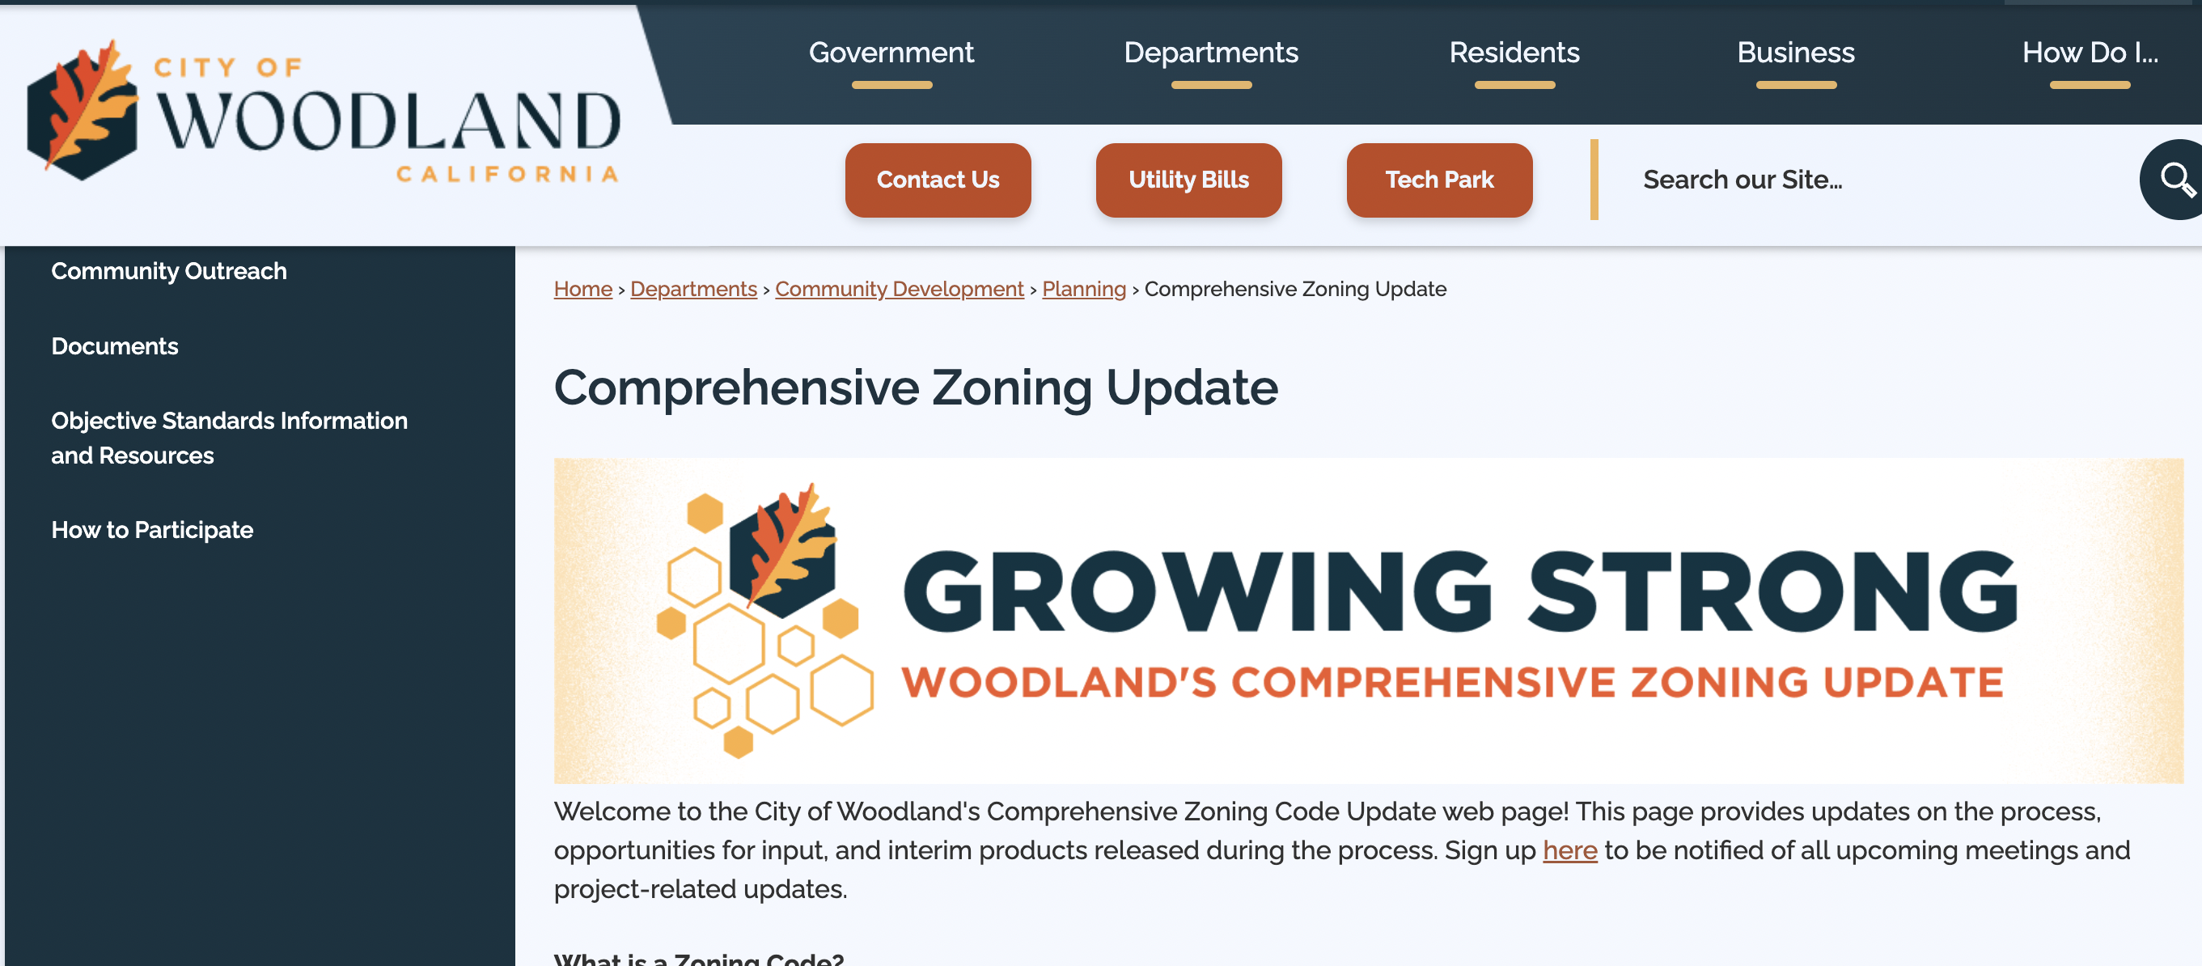

How to Get Involved
Review the Comprehensive Zoning Code Web Page:
  https://cityofwoodland.org/1165/Comprehensive-Zoning-Update
  Or bit.ly/woodlandzoning
Watch Recorded Meetings and Webinars (All meetings recorded)
Attend Meetings and Workshops
Email comments and questions: compzoneupdate@cityofwoodland.org
Copies of the Code may be viewed at the following:
Community Development Department, Library, Community & Senior Center
On-line on the Comprehensive Zoning Code Web page.
Notes:
This last slide provides information on how to get involved.
Copies of the Draft CZC are available on-line and on the Comprehensive Zoning code web page. PDF versions of each Division and maps may be downloaded.
Copies may be viewed at the CDD, the Library and at the Community and Senior Center.
Additionally, please continue to check the web page, watch recordings, and attend meetings.

Slide 26
Thank you!

