Slide 1
A Review of Division II & III – Industrial Area Focus
Notes:
Will provide a brief overview in order to provide some background – if you wish to see a more In depth discussion you may view prior meetings including recordings, staff reports, and power point presentations on the CZC web page. Which I will reference later in the presentation.
Before we get started I would like to ask if there are any specific questions that you may have that we can respond to or cover in the presentation? We will pause for breaks if needed to allow for questions and will have discussion at the end of the presentation as well.
The intent is to provide an overview of the project, the guiding principles and to highlight where there may be proposed changes.
This is a draft document. We are seeking to present the proposed updates and changes and to have input and conversation about them. Your input and feedback regarding this document will only serve to make it a stronger and better tool for the future.

Slide 2
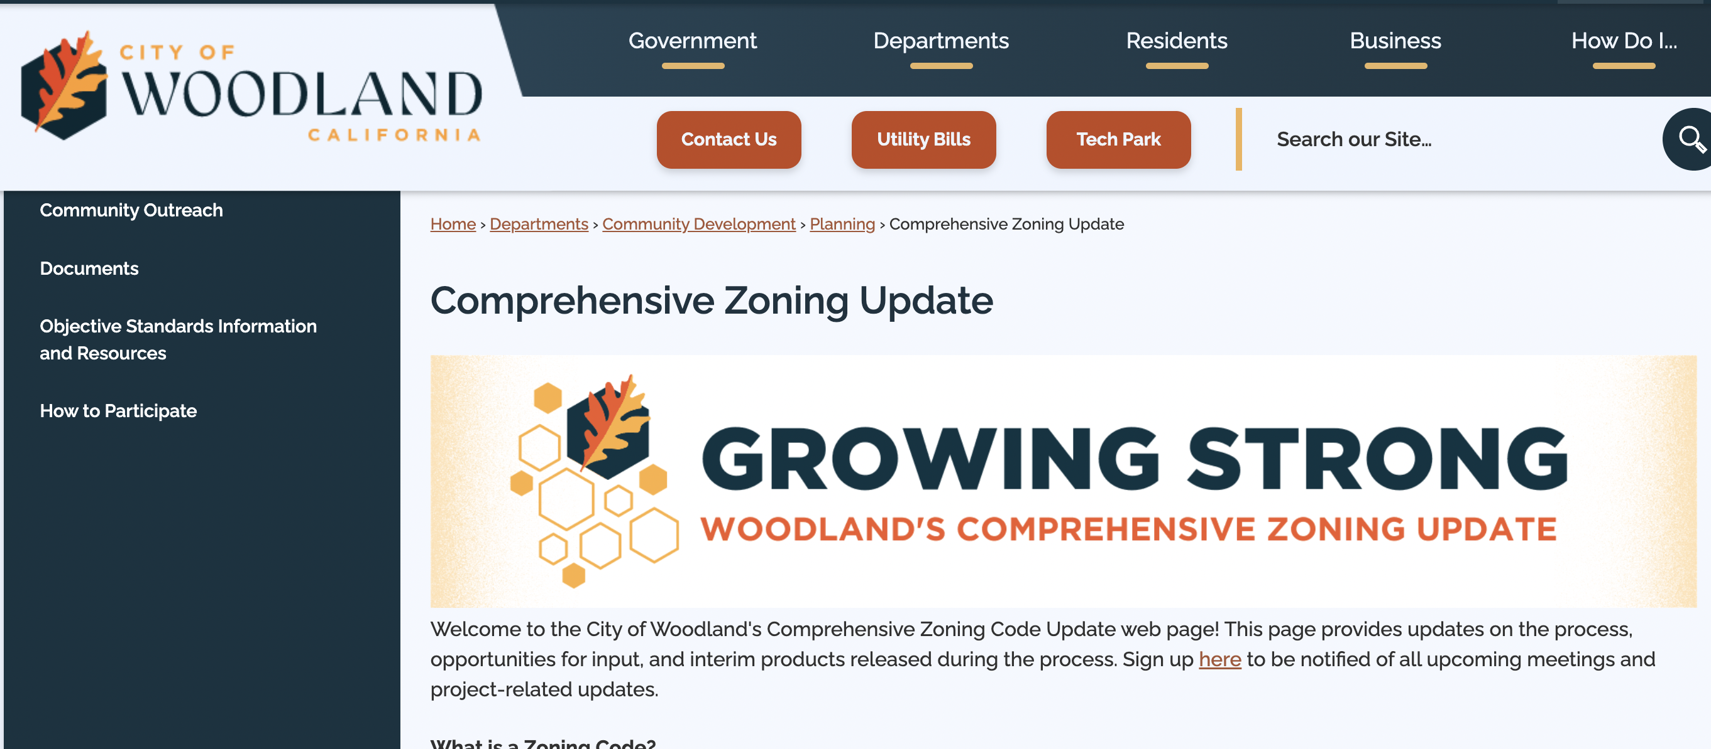

Agenda
General Plan Background and Direction
Zoning Map Overview
Industrial Related Code Provisions
Industrial Related Topic Areas of Note
Comprehensive Zoning Code Web Page:
https://cityofwoodland.org/1165/Comprehensive-Zoning-Update
Or bit.ly/woodlandzoning
Notes:
As I said, there will be a brief discussion regarding the background and direction for the CZC update.
We will provide an over of the proposed zone map changes as well as proposed changes to uses and standards. (for the most part, the standards and uses are very similar to those that are incorporated in the Interim Z C with some modifications. Changes are based upon experience with using the IZC, and actions and direction from the City council.

Slide 3
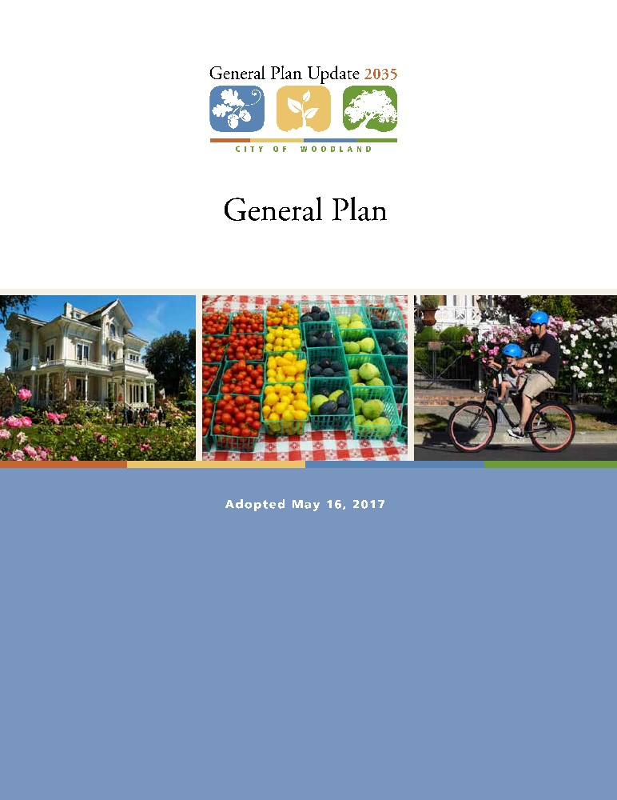
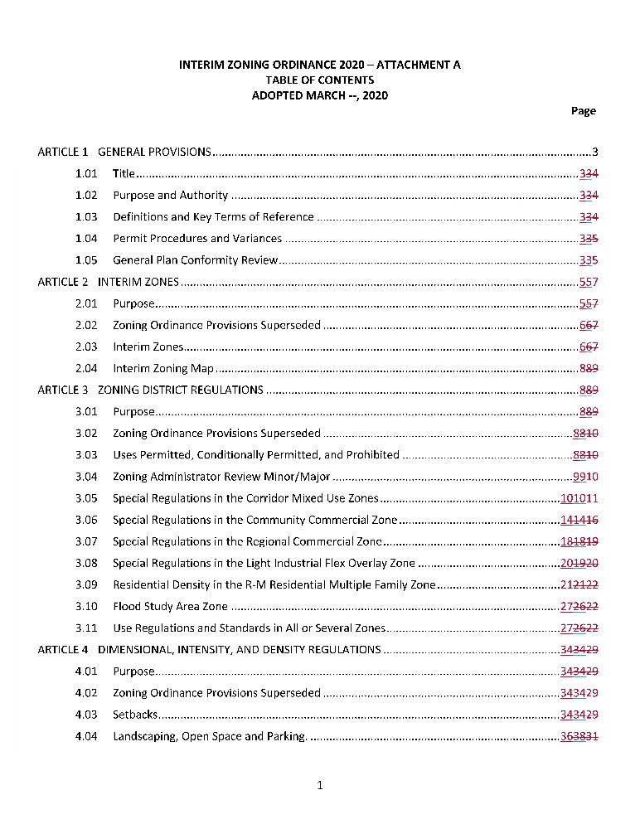
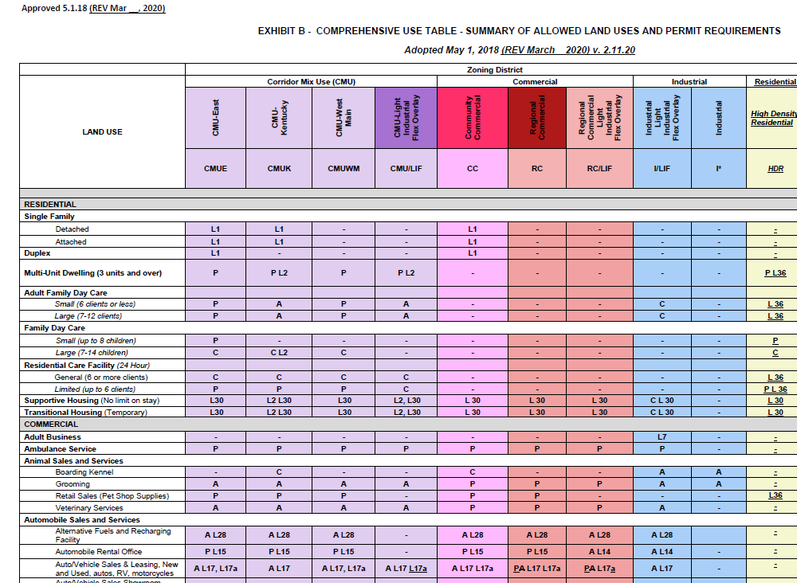
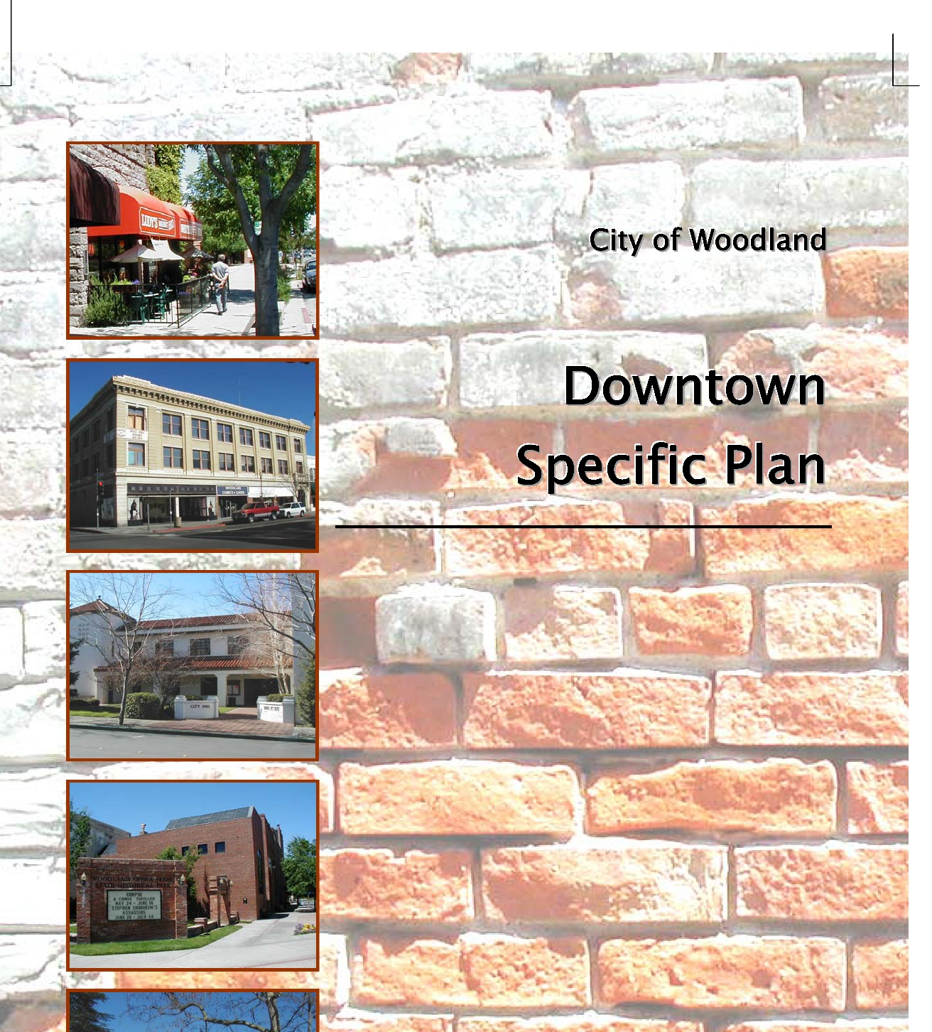
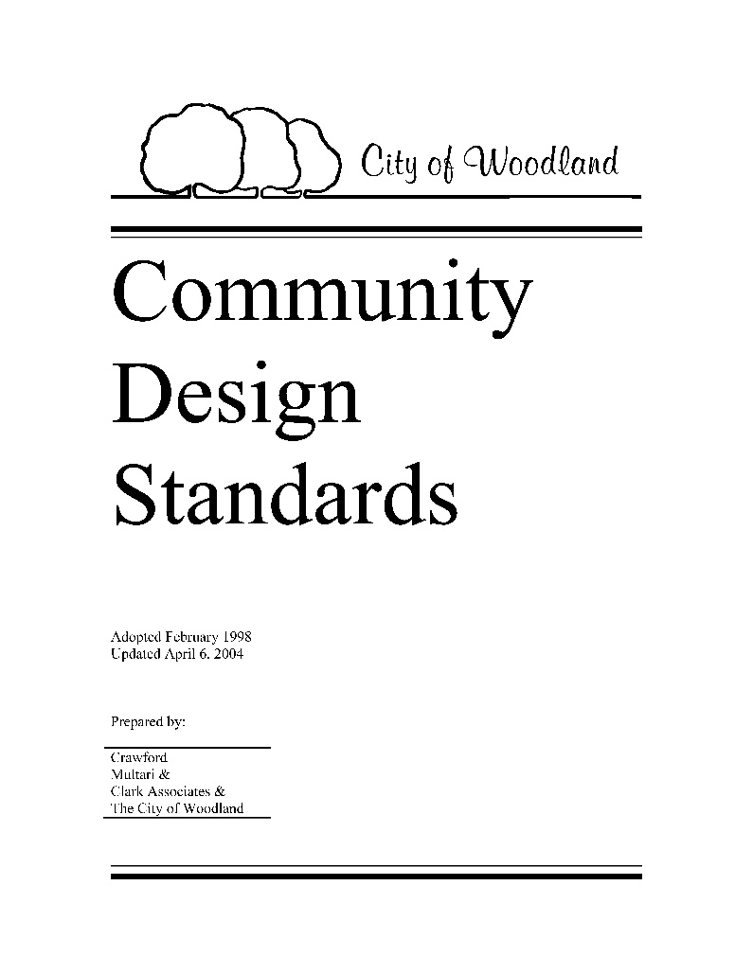
Project Objectives
Implement the City’s General Plan policies
Reflect community character
Respond to economic realities and trends
Facilitate reinvestment in the community and development of housing for all segments
Build on Interim Zoning
Replace the Downtown Specific Plan with a new Downtown section of the Zoning Code
Create a legally adequate regulatory document
Be user-friendly and all in one document
Stay within existing CEQA clearance
“A well-designed city that incorporates appropriate development standards into its regulations will directly elevate the quality of life and appearance of the community, attract investment, an increase communal pride.”
“Clearly written standards and a streamlined review process will assist staff and decision makers to allow qualified development with expedited review, thereby helping to reduce the front-end design/development costs particularly for new housing projects.”
Notes:
There were serval Key objectives we have kept in mind as we began the code update. This slide provides a summary of the main objectives.
Overarching is the need to be consistent with the 2035 General Plan and the vision outlined in that document in the form of goals and policies as well as address legislative updates.
The code will provide a one-stop source for all areas within the City’s boundaries. Will incorporate the best of and replace the DTSP, Community Design Standards, and the IZO.
The code must respond to legislative changes required by the State and must be a legally adequate document.
Importantly, the code will reflect existing community character while also recognizing the need to change and grow.
It is also hoped that the new code will facilitate continued reinvestment in the community, similar to what has been achieved with the IZO.
The basic underlying task of the CZC update is to facilitate new desired development through the provision of clear and understandable standards, guidelines, and procedures.
Clearly written standards and a streamlined review process will assist staff and decision makers to allow qualified development with expedited review, thereby helping to reduce the front-end design/development costs particularly for new housing projects.
The code also utilizes best practices to facilitate livability, sustainability, increased density, and multi-modal access.
In the period immediately following adoption of the General Plan, the City adopted a stand-alone Interim Zoning Ordinance (IZO) to address areas of land use inconsistency between the newly adopted General Plan and Zoning, primarily for the commercial, industrial and mixed-use zones. The IZO incorporated new standards and practices that have guided much of the new development that has occurred since 2018. The IZO has generally been considered successful and the CZC has built upon the best elements and lessons learned through use of the IZO. Therefore, in many respects, the standards and uses for the CMU, Commercial, and Ind zones will not differ significantly from those contained in the IZO, with the exception of new objectively written standards.

Slide 4
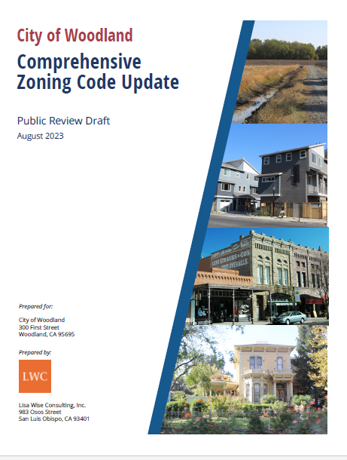
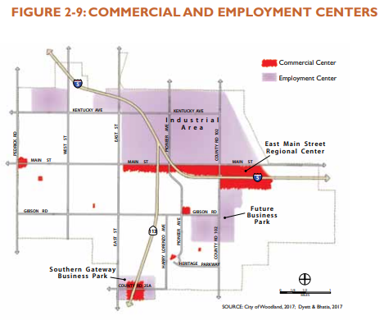
Zoning Code Relationship to General Plan
The Zoning Code is a tool that implements the goals and policies of the General Plan
Woodland’s General Plan was updated in May 2017 after a four year planning and review process involving community members, local stakeholders, and based on the guidance and direction of elected and appointed officials
The General Plan establishes goals and policies for the future growth of the City including where development should happen, the types of development and the intensity of development
The Zoning Code and General Plan shall be consistent with each other
Notes:
The GP is the City’s overarching policy document. It sets long term goals, through the year 2035, policies and implementation programs. Through the 4-year General Plan updated process, the city received written and oral comments from over 100 individuals, groups, and agencies with over 400 individual comments.
The Zoning Code is an implementation document….implementing the Policies outlined in the General Plan. The Zoning Ordinance and GP must be consistent with each other. The ZP is a regulatory tool to implement the GP>

Slide 5
General Plan Related Goals and Policies
General Plan Goals and Policies Pertaining to Industrial Development
Goal 2.C – Smart Growth, Sustainability, and Regional Coordination. Promote Woodland as a leader in sustainable development and support statewide and regional efforts to encourage smart growth, reduce greenhouse gas emissions, fund transportation improvements, conserve resources, and maintain fiscal sustainability.
Goal 2.D. – Economic Development – Promote economic growth and vitality by bolstering key industries and encouraging balanced job growth.
Policy 2.D.2 – Food and Agriculture Industry Cluster. Develop Woodland into a premier food and agriculture industry cluster by providing appropriate infrastructure, adequate land with compatible land uses, and by supporting research and technology.
Policy 2.D.3. – Technology Sector. Grow the technology sector in Woodland by leveraging the research strength at UC Davis. Establish business parks in the Southern Gateway at CR25 and SR 113 and along CR 102. Encourage smaller companies and startups to locate in incubator spaces Downtown and in areas with the Light Industrial Overlay designation.
Policy 2.D.4 - Made in Woodland. Incentivize continued support for skilled handcraft “maker” businesses that help grow a diversity of products with the “Made in Woodland” brand.
Notes:
As stated in the General Plan, the GP Goals and policies provide for strategic growth and change that:;
Prioritizes sustainability measures community wide as well as through new development and redevelopment practices. One example, of sustainability occurring through redevelopment or on/going improvmeents is the number of businesses that are turning to solar installations.
Additionally, the GP prioritizes and promotes economic development
Prioritizes Food and Agriculture related industries
Prioritizes Research and Technology related uses
Prioritizes and protects businesses that feature made in woodland products.
This slide highlights a few Employment and Industrial related goals and policies of the General Plan… The GP utilizes the term “employment center” to refer to the industrial sector.
Woodland has a very large and diverse industrial area with a significant amount of land area devoted to employment/Industrial uses.

Slide 6
General Plan Related Goals and Policies- continued
Goal 2.K – Employment Centers. Provide business park, industrial, medical, public employment centers that encourage a range of diverse business and employment opportunities and feature multimodal commute access.
Policy 2.K.1 – Quality Design. Require new and renovated business parks, public buildings and industrial properties to feature elements such as attractive entrances, articulated building facades and rooflines, attractive landscaping, and shaded walkways.
Policy 2.K.3.- Northeast Industrial Area. Promote clustering of industrial uses into areas that have common needs and impacts in order to maximize their efficiency and minimize conflicts. Provide for industrial uses that require a larger footprint on the east side of the northeast industrial area. Provide for smaller uses on the west side.
2.K.4.- Light Industrial Overlay. Utilize the Light Industrial Overlay designation to transition between districts of different intensity, accommodate small incubator space, and promote a mix of agricultural, biotechnology, and emerging technology companies.
2.K.5. – CR 102 North. As the industrial area builds out, provide enhanced roadway and streetscape improvements to CR 102 North to improve accessibility and the visual appearance of the eastern portion of the industrial area.
2.K.6.- Transition Areas. Require industrial development to incorporate context-responsive transitions to minimize impacts on nearby land uses.
2.K.7 – Alternative Transportation Modes. Promote convenient, attractive, and safe pedestrian, bicycle, and transit connections both within employment centers and between centers and surrounding uses.
Notes:
With a large area devoted to Industrial/employment related uses the city benefits from a diverse range of business and employment. A goal of is to continue to do so and enhance the employment areas to the extent possible over time and ensure adequate types of access to all. Called multi-modal access – auto, bike, pedestrian and transit opportunities.
Prioritizes quality design for new or renovated development and uses. (features such as attractive entrances, building design, landscaping and shaded areas) - tie into the sustainability goals, including reducing heat related impacts.
NE Industrial area – Goal to organize uses by common needs. The area west – emphasis on small uses that may also have R & D, food production, or other similar uses that might have greater sensitivities to environmental outputs such as odors, particulate, vibration, etc.. To the east, there is adequate land area available to accommodate uses that may have a larger footprint or be considered heavier industrial – outputs, outdoor production, needs.
As areas develop, the goal and polies are to provide for attractive roadway and streetscape improvements to enhance safety, accessibility, and the visual appearance.
As mentioned previously, a priority not only in the Ind areas, but citywide, is to increase and enhance alternative transportation options. (woudnt it be great if in the future, local workforce who live in town could feel comfortable and safe either walking or biking to work?)

Slide 7
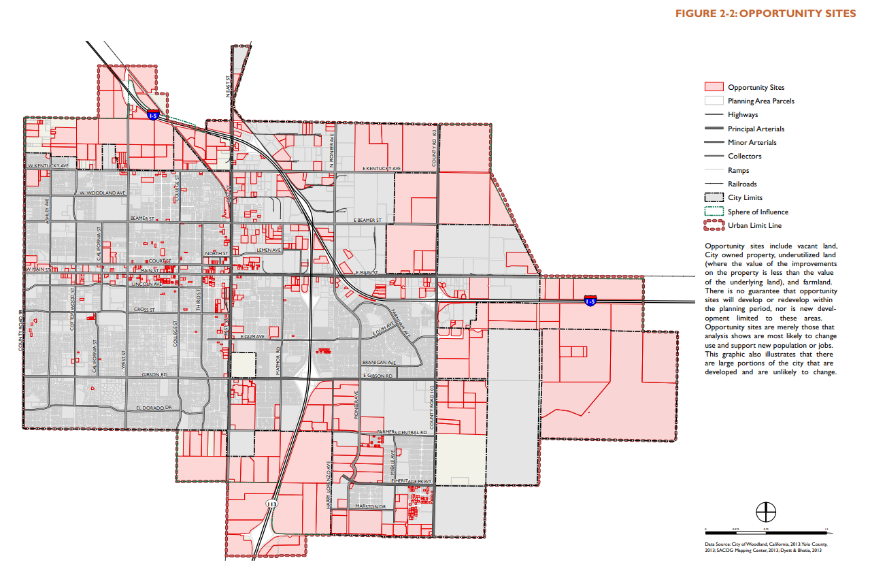
Notes:
Much of Woodland, is not expected to change substantially during the planning horizon of the General Plan, through 2035. However, there are some areas where the city does expect to see change. These areas include Downtown, major corridors, the industrial area, and large areas of land designated for future growth. Many of the goals and policies of the General Plan are focused on supporting growth in these areas.
This figure identifies development “opportunity sites” across the city and out to the ULL that include vacant land, City owned property, underutilized land (where the value of the improvements on the property is less than the value of the underlying land), and farmland. There is no guarantee that opportunity sites will develop or redevelop within the planning period, nor is new development limited to these areas. Opportunity sites are merely those that analysis shows are most likely to change use and support new population or jobs.
The grey areas are largely built out with existing, established neighborhoods.

Slide 8
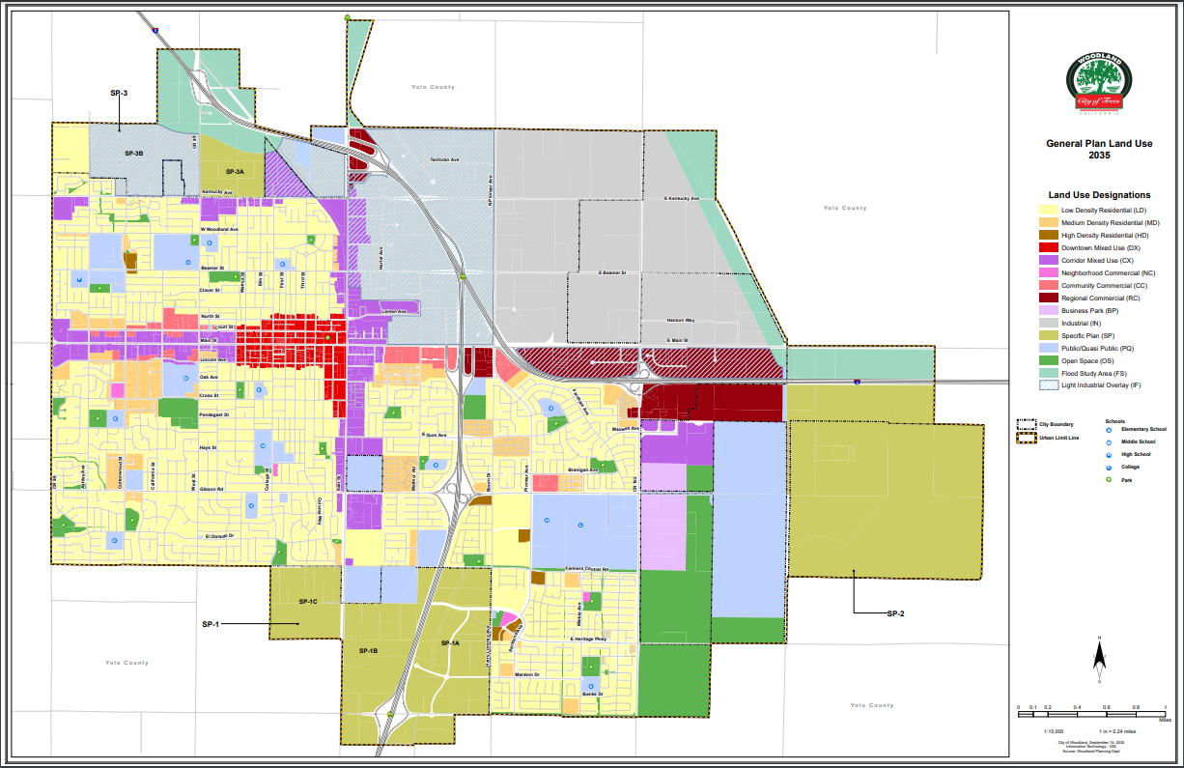

Industrial w/LIF
Industrial
Notes:
Ultimately then the General Plan land use map reflects the goals and policies around future growth and development, acknowledging both established communities as well as areas where future growth is likely to occur…those Opportunity sites….land use designations then allow proper intensity and density regulations that ultimately get carried down to the implementing zoning code and map.
Areas in Grey – and Grey with blue overly (hash lines) – show the primary industrial designated land in the City. The 2035 GP added a new overlay to the general Ind zone, called a light industrial overlay (LIF). Referring back to the GP policies, the idea was to help identify uses with more common needs. Smaller uses with more sensitivity considerations included in the LIF overlay where as a range of uses including larger heavy industrial uses allowed to the east.
May also notice the LIF overlay both over RC and CMU. Purpose to allow a broader range and mix of uses, in many cases reflective of what already exists on the ground. With the LIF overlay there is allowance for the possible addition of light industrial type of uses.

Slide 9
ENCOURAGING INDUSTRIAL DEVELOPMENT
Proposed Increase in Areas with the General Industrial Designation
By Right Zoning for Uses that Facilitate Economic Development Goals
Discretionary Review for Uses Light Industrial Areas that May Have Possible Impacts to Adjacent Use or Possible Visual Impacts.
Continuing Requirements to Limit and/or Screen Outdoor Storage/Truck/Freight. (in compliance with moratorium)
Warehouse/Storage/Distribution Uses Further Defined
Fencing Requirements Updated
Landscaping and Shading Requirements Updated
Notes:
Steps taken to encourage industrial /employment generating development in compliance with goals and policies of the GP.

Slide 10
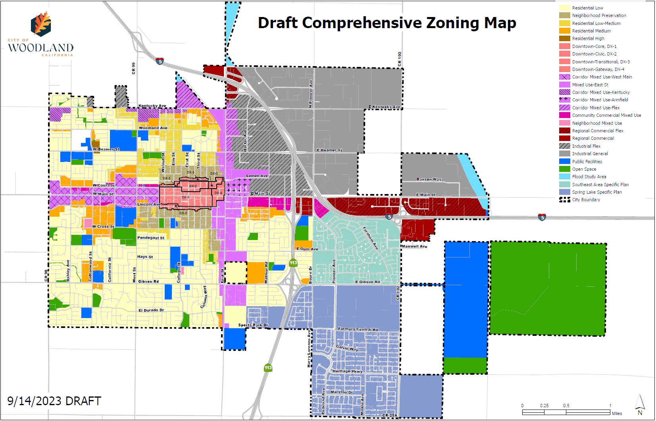
Notes:
Comprehensive Code Update, Zoning Map. As a note, zoning only covers areas that have been annexed into the City and are within our city boundaries. I have included in the outline a few areas that are proposed to be annexed at some time in the future, particularly to the NE, in which an annexation effort is underway.
This map show the proposed expansion of the GI area west of Pioneer Avenue to the I 5 freeway. There are a few areas to the north as well. Otherwise, the land area shown as industrial is the same a currently zoned.

Slide 11
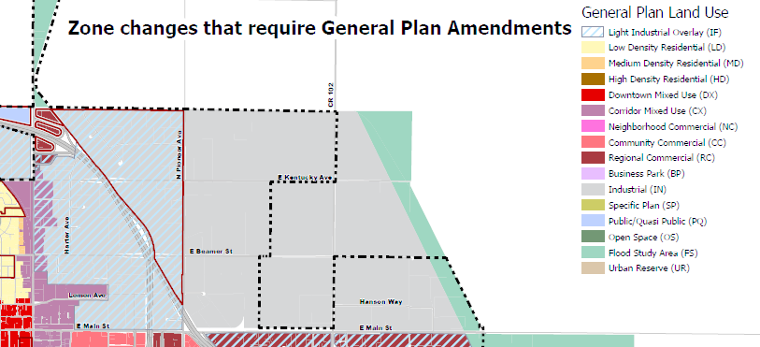
Proposed Areas of Industrial Change

Slide 12
Code Format
Division I: General Provisions
Division II: Zoning Regulations
Division III: Citywide Standards
Division IV: Administration and Procedures
Division V: Definitions
Notes:
The updated code has a new format and structure – divided into 5 Divisions.
Division I – purpose and rules of measurement
Division II – provides the specific standards for each zone
Division III – provide standards that apply citywide – parking, fencing, lighting, screening; as well as standards that apply to specific uses – citywide; as well as updated Non-Conforming standards
Division iV – provides all of the procedures and entitlement review requirements.

Slide 13
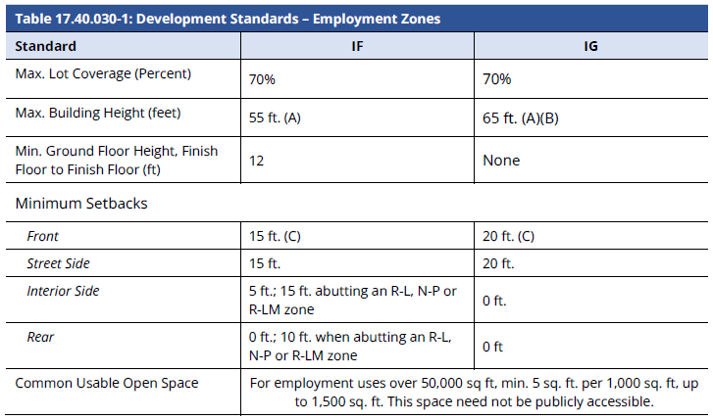
Development Standards – Industrial Zones
Notes:
Moving into Division II of the code, where development standards are outlined.
Standards (setbacks and coverage same as provided in the ZC and IZO)
New – requirement for common open space for larger new development over 50,000 sf for employee open space.
Lot coverage measures the proportion of a lot that is covered by structures. Lot coverage limitations help to promote the aesthetic qualities of open space for landscaping and privacy and can also help reduce excessive storm water run-off and help provide usable yard spaces by restricting the horizontal overbuilding of properties.

Slide 14

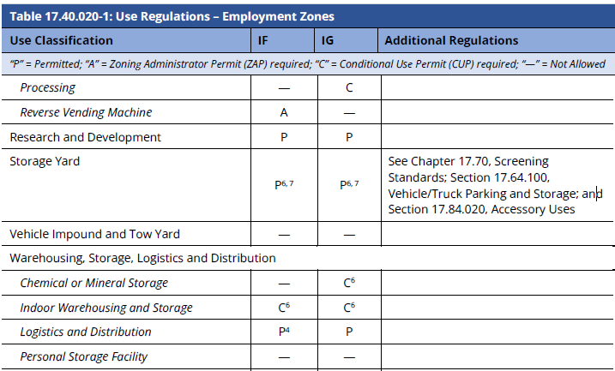
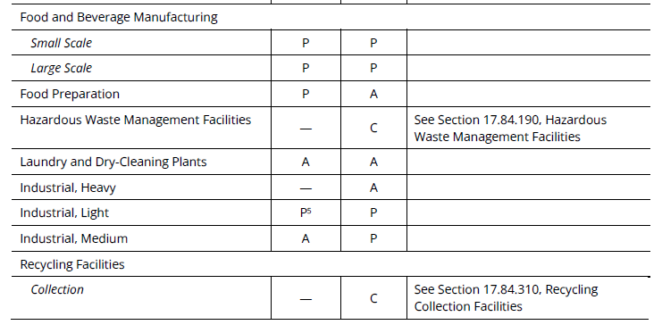
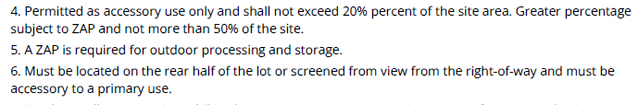
Development Standards – Industrial Zones
Notes:
Use Table,
Permitted, conditionally permitted and prohibited uses.
P, A, C, -
Footnotes
Reference to other key sections in the right hand column.
There has been some fine tuning to the use table in order to provide greater clarity and to address aeas where there have been past issues or concerns.

Slide 15
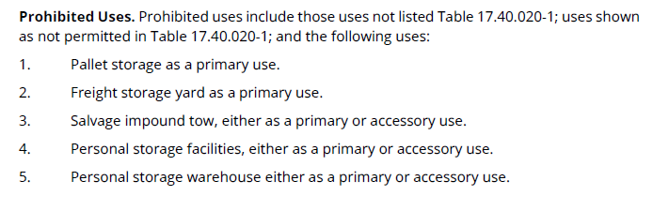
Development Standards – Industrial Zones

Slide 16
Division II: Zoning Regulations
17.56: Building and Site Design Standards
17.56.010 General Design Standards
17.56.020 Single-Family and Duplex Design Standards
17.56.030 Multi-Unit Design Standards
17.56.040 Small Lot Subdivision Design Standards
17.56.050 Preservation/Restoration of and Additions to Historic Structures
17.56.060 New Development or Renovation of Non-Historic Structures Design Standards in the Downtown Zones
17.56.070 Mixed Use, Commercial and Employment Zones Design Standards
17.56.080 Public Facilities and Open Space Zones Design Standards
E. Industrial Building Frontage Design. Street-facing façades shall include applied surface elements or detailing to promote visual interest. This may include but is not limited to moldings/trim, brackets, niches, and decorative entrances.

Slide 17
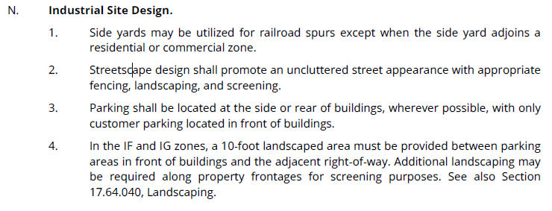
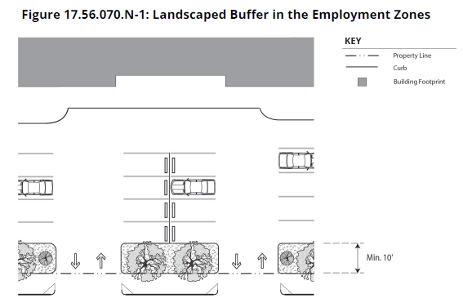
Division II: Zoning Regulations
17.56: Building and Site Design Standards
17.56.010 General Design Standards
17.56.020 Single-Family and Duplex Design Standards
17.56.030 Multi-Unit Design Standards
17.56.040 Small Lot Subdivision Design Standards
17.56.050 Preservation/Restoration of and Additions to Historic Structures
17.56.060 New Development or Renovation of Non-Historic Structures Design Standards in the Downtown Zones
17.56.070 Mixed Use, Commercial and Employment Zones Design Standards
17.56.080 Public Facilities and Open Space Zones Design Standards

Slide 18
HIGHLIGHTS
Notes:
As mentioned, many of the requirements and standards proposed in the Code for the Industrial areas are a continuation of standards provided in the City’s Interim Zoning code (approved and used since 2018)
I have outlined the Division II standards. There are additional criteria provided in the City wide standards – Division III. I will highlight those that have been clarified or updated.

Slide 19
Fence Heights in Industrial Zones (Updated)
CZC Section 17.64.030
Front Yard Fence Placement and Height Exceptions
A tubular steel fence up to six feet in height is allowed 10 feet from the back of sidewalk in the RCF, IF, and IG zones provided a landscaped and irrigated planting strip composed of climbing vines, shrubs, and trees, is provided along the base of that portion of the fence that abuts the public street or public right-of-way. The remaining setback area between the fence and property line shall be landscaped and maintained in a healthy and growing condition.
If necessary for security purposes, as determined by the Director, tubular steel, or equivalent open welded metal fencing, may be placed at the back of sidewalk in the RCF, IF, and IG zones as long as the required landscaping is visible through the fencing.
Additional Fence Height. Additional fence height up to eight feet may be considered by the Director (Development Review Tier 1) if located outside of a required front setback and more than five feet from a street lot line, provided that the Director determines that the additional height is necessary due to specific circumstances related to on-site safety and security and the fence is designed appropriately to minimize negative visual impacts to neighboring properties.
Notes:
Division III. There are proposed updates to restrictions regarding fencing height and placement.
Proposal to allow taller fencing closer to the street as long as it is primarily open or transparent.
Tubular steel fence up to 6-feet is allowed 10-feet back of the sidewalk/PL, and there is a landscape planter between the ROW and the fence.
If applied for and determined by the director, There may be conditions where an open tubular steel fence may be provided at back of walk. However, the minimum 10 ft required landscaping must be provided back of the fence.
Additional fence height, up to 8-feet may be considered, if located outside of a required front setback and findings are made that it is necessary for on-site safety and security.

Slide 20
Fence Heights in Industrial Zones (Updated)
CZC Section 17.64.030
Limitations on Chain-Link Fencing.
b. Visibility. Chain-link fencing shall not be located in a front or street side yard setback area, or where visible from the street, a State highway, or an adjacent Residential zone. Exceptions may be granted by the Director in the IG and IF zones for powder coated chain link.
Prohibited Fencing Materials. The following fence materials are prohibited in all zones
A. Barbed wire or electrified fence.
B. Razor or concertina wire, climb-proof spikes, or other hazardous fencing in conjunction with a fence or wall, or by itself.
Exception. (New) The Zoning Administrator, or appropriate review body, may approve an exception to fence types listed in subsection A or B through a Development Review Tier 3 review process, for sites in industrial districts, provided the hazardous fencing materials are located at the top portion of a fence which is at least six feet in height where the Director finds such fencing is necessary for security purposes, and is not visible from public rights-of-way. Electrified fencing shall meet all applicable standards as established in California Civil Code Section 835.
Notes:
Regarding fencing material, consistent with the current code, chain link fencing shall not be located in the front or street side yare setbck or where visible from a street. Exemptions may be granted by the Director through DR, in the IG and IF zones for a powder coated chain link.
Prohibited fencing materials include barbed wire, electrified fencing, or other improvised security measures such as broken glass or nails.
Some exceptions may be considered through a Tier 3 DEV Review, (noticing) for sites in the Ind districts.

Slide 21
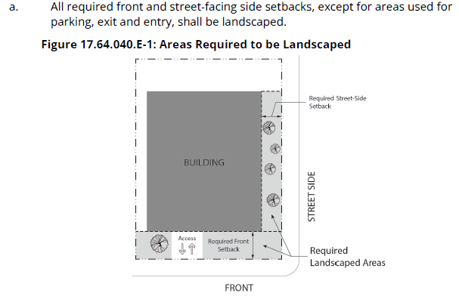

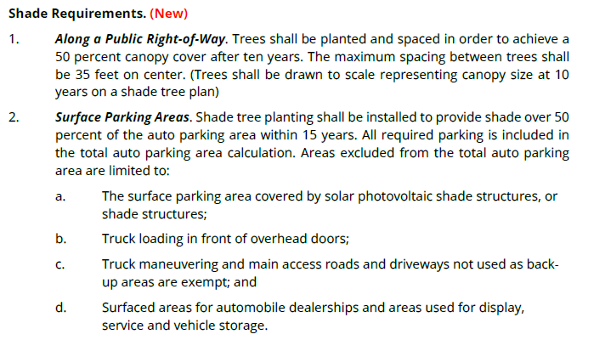
Landscaping (Updated)
Trees
Notes:
The landscape section of the Code has been updated generally.
There are updated requirements regarding parking lot shading (consistent with the Buidlign Green Code) 50% shading. There are some exceptions , such as truck loading areas, truck maenuvering areas (consistent with existing code exceptions)
Newer updated standard regarding tree planting along the ROW, 50% canopy cover after 10 years.
Graphic illustrates required areas to be landscaping. In the Industrial/Employment zones trees are only required along the front or exterior side perimeter of a parcel, except for Auto Parking shade requirements will apply.

Slide 22
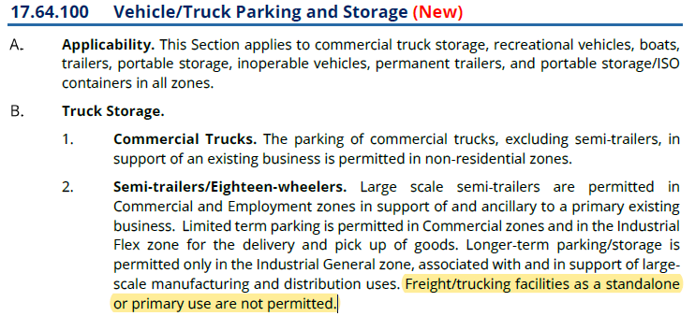
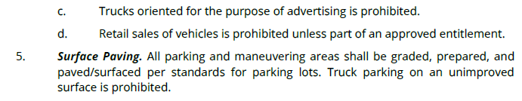
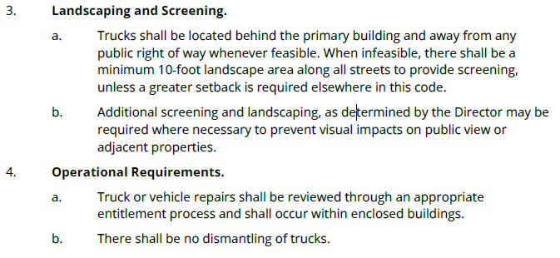
Truck Parking Storage (Updated)
Notes:
Division III – city wide standards includes a section related to Vehicle/Truck Parking and Storage. Continuation of requirements in the IZO.
Based on past experience that the code needs to provide clearer guidance regarding requirements relating to truck parking.
Recognized that truck parking is needed in support of most industrial businesses.
Trucks should be parked behind a primary buldng, and away from the Public ROW. When possible at minim 10-foot landscape area is required along streets to provide screening.
It is noted that in line with the moratorium approved by the City council, truck parking as a stand alone primary use is not permitted.

Slide 23
Outdoor Storage (Updated)
17.70.040 Outdoor Storage Areas
All uses or activities shall be conducted wholly within completely enclosed buildings, and no outdoor storage shall be allowed between the primary building and the sidewalk or street, except as may be provided as a specified land use in allowed use tables of Division II, Zone Regulations.
All allowed on-site outdoor storage areas shall be screened from view from any public street or freeway; existing or planned Residential zone; or publicly accessible open space area, parking area, access driveway, or similar thoroughfare.
Location of Outdoor Storage Areas.
1. Outdoor storage may only be allowed in conjunction with and as an accessory use to an existing business with an active business license. Primary use outdoor storage or truck parking lot is not permitted.
2. Outdoor storage may not be located within any required front or street side yard.
3. If outdoor storage is adjacent to a residential district, a Zoning Administrator Permit is required.
Screening. All materials and outdoor storage areas must be fully screened so as not to be visible from any rights-of-way and shall be located below fence height, wall, or building.
Notes:
Outdoor storage criteria have been updated. Provisions were generally provided in the IZO, but further clarification is provided.
Generally outdoor storage is allowed as an accessory use to an existing business. Outdoor storage as a primary use, including truck parking, is not a permitted use/
When allowed, it shall not be located within a required front or street side yard.
All outdoor storage areas must be fully screened from any public street. Below fence height or behind a building.

Slide 24
Division III: Citywide Standards
17.80 Nonconforming Provisions - Updated
Determination of Nonconforming Uses, Structures, and Lots
Nonconforming Uses
Continuation and Maintenance of Nonconforming Structures
Alterations and Enlargements to Nonconforming Structures
Repair and Replacement of Damaged or Destroyed Nonconforming Buildings
Abandonment or Discontinuance of Nonconforming Uses
Nonconforming Signs
Legal v Illegal Nonconforming status (Originally permitted or not)
Defines Nonconformities (When a use or structure has a right to continue)
Nonconforming Lots (Lots smaller than minimum requirements)
Changes or Substitutions of Nonconforming Uses (Process for review of changes. Defines intensification of use and identifies property improvements that may be required upon change in tenancy or ownership)
Abandonment (A nonconforming use of a building or structure ceases for a continuous period of 6-months. Defines when a use ceases to operate. Allows the Director to grant a 6-month extension if economic conditions warrant the additional time.)
Notes:
A legal non-conforming use is a use that was originally permitted, but due to changes in standards or code or the General Plan, it may not longer be consistent with current code requirements.
The Non-conforming section has been updated to provide better clarity to address the many complexities relating to non-conforming situation. to address either non-conforming uses or non-conforming structures/buildings has been updated to provide clearly stated requirements that address the many considerations of non-conforming situations.

Slide 25
DISCUSSION
Notes:
We are looking forward to hearing feedback regarding the document. It is a draft and we understand that there may be new information that is discovered and comments received which could result in changes and updates.
Further, the Code is a living document, and even once approved, the document may continue to evolve over time as new situations and considerations present themselves.

Slide 26
Next Steps
Proposed Public Meeting Schedule:
Meetings may be subject to change, so please continue to check the CZC web site for up-to-date information.
Please join the City of Woodland staff at one or more of the scheduled workshops concerning the Public Review Draft Comprehensive Zoning Code Update on the following dates:
Thursday, October 5 @ 6:30 PM – Planning Commission Workshop
Wednesday, October 18 @6:00 PM – Commercial and Mixed-Use focus
Thursday, October 19 @6:30 PM – Planning Commission Workshop - Housing focus
Tuesday, October 24 @ 11:30 AM – General and Industrial focus
Wednesday, October 25 @ 9:00 AM – Downtown focus
All meetings will be held in the City Council Chambers, 300 First Street, City Hall and will be recorded and posted on the Comprehensive Zoning Code web page.
Notes:
The Team will begin to host a series of workshops and information sessions.
All meetings will be recorded and posted on the Comprehensive Zoning Code web page to allow members of the public the ability to view all presentations and discussions.
The city will offer a range of meeting types from pre-recorded to in person. If we are able, one or more may be hybrid with virtual attendance allowed. In person meetings will be held at the City of Woodland Council Chambers, located at 300 First Street.
Meetings will be scheduled at varying times, evenings, morning, and lunch time to hopefully accommodate all schedules.
More information regarding meeting will be provided.
Outreach will be conducted using notices in the newspaper, direct mailings, email to identified interested parties, and various forms of social media including press releases, notices to list serve groups, and posting on the city’s web page.
Suggest checking the web site often to see if there are changes in meeting dates or times or additional scheduled meetings.
We are looking forward to hearing feedback regarding the document. It is a draft and we understand that there may be new information that is discovered and comments received which could result in changes and updates.
Further, the Code is a living document, and even once approved, the document may continue to evolve over time as new situations and considerations present themselves.

Slide 27

How to Get Involved
Review the Comprehensive Zoning Code Web Page:
https://cityofwoodland.org/1165/Comprehensive-Zoning-Update
Or bit.ly/woodlandzoning
Watch Recorded Meetings and Webinars (All meetings recorded)
Attend Meetings and Workshops
Email comments and questions: compzoneupdate@cityofwoodland.org
Copies of the Code may be viewed at the following:
Community Development Department, Library, Community & Senior Center
On-line on the Comprehensive Zoning Code Web page.
Notes:
This last slide provides information on how to get involved.
Copies of the Draft CZC are available on-line and on the Comprehensive Zoning code web page. PDF versions of each Division and maps may be downloaded.
Copies may be viewed at the CDD, the Library and at the Community and Senior Center.
Additionally, please continue to check the web page, watch recordings, and attend meetings.

Slide 28
Thank you!

